Slide 1
DBL embedded systems group 16
Made by:
Wigger Boelens
Rolf Verschuuren
Stefan van den Berg
Notes:
Rolf: machine design + intro

Slide 2
Machine Design
Reliability
Speed
Robustness
Accessibility
Floor space
Complexity
Amount of parts

Slide 3
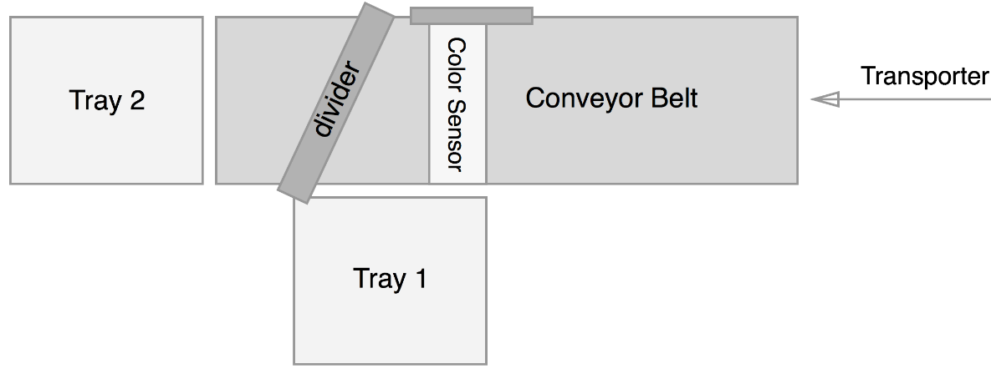
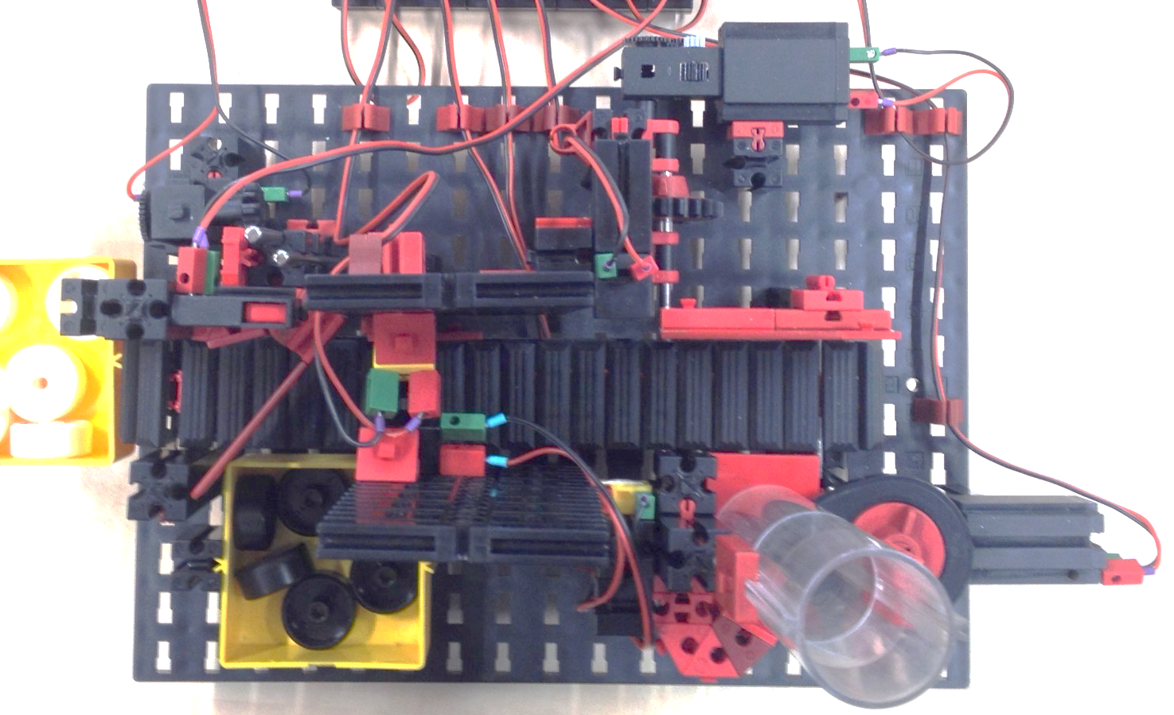
Machine Design

Slide 4
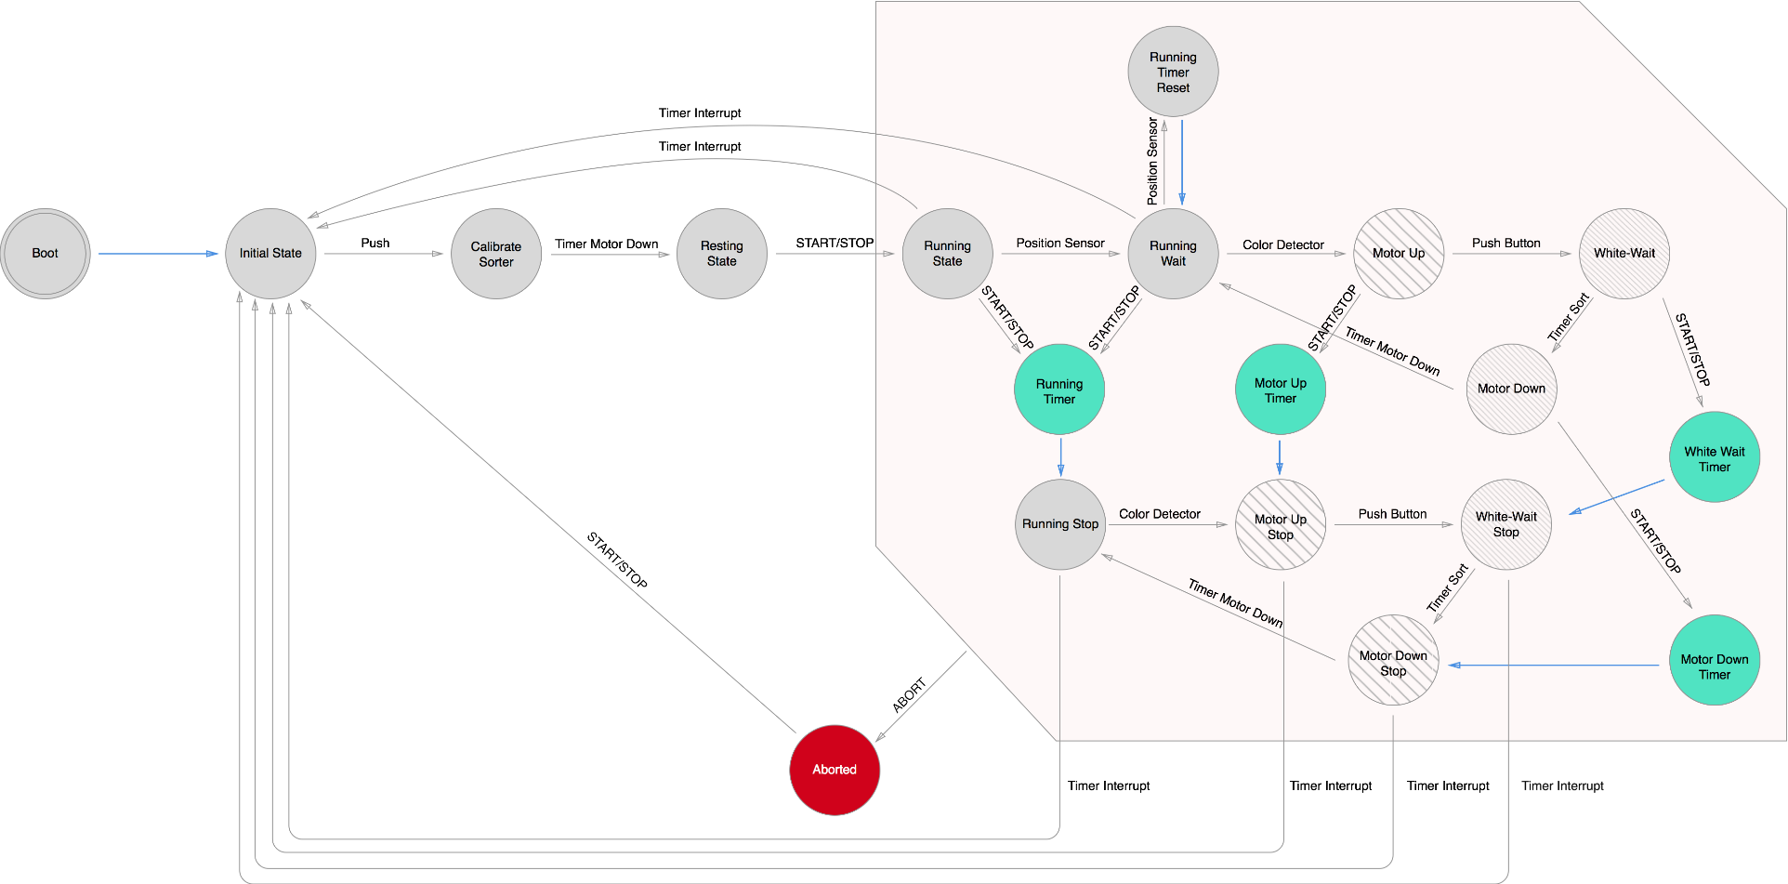
Software Design

Slide 5
Software Design
176 void running() {
177 timerManage();
178 //check if we need to pause
179 $startStop = getButtonPressed(0);
180 if ($startStop == 1) {
181 //stop the feeder engine
182 storeData(0, "outputs", FEEDERENGINE);
183 //set the timer
184 setCountdown(BELT);
185 //update the state
186 $state = 9;
187 runningTimer();
188 }
189 //check if a disk is at the position
190 // detector
191 $position = getButtonPressed(7);
192 if ($position == 1) {
193 //reset the countdown,because a
194 // disk was detected
195 setCountdown(BELTROUND + BELT);
196 //update the state
197 $state = 4;
198 runningWait();
199 }
200 //loop
201 running();
202 }

Slide 6
Software Design
141 void running() {
142 timerManage();
143
144 //check if we need to pause
145 $startStop = getButtonPressed(0);
146
147 if ($startStop == 1) {
148 //stop the feeder engine
149 storeData(0,"outputs",FEEDERENGINE);
150
151 //set the timer
152 setCountdown(BELT * 10);
153
154 //update the state
155 storeData(9,"state",0)
156
157 runningTimer();
158 }
159
160 //check if a disk is at the position detector
161 $position = getButtonPressed(7);
162 if ($position == 1) {
163 //reset the countdown,because a disk was detected
164 setCountdown(BELTROUND+BELT);
165
166 //update the state
167 storeData(4,"state",0);
168
169 runningWait();
170 }
171
172 //loop
173 running();
174 }
198 function running()
199 {
200 timerManage();
201
202 //check if we need to pause
203 $startStop = getButtonPressed(0);
204 if ($startStop == 1) {
205 //stop the feeder engine
206 $temp = 0;
207 storeData($temp, 'outputs', FEEDERENGINE);
208 unset($temp);
209
210 //exit after 1 rotation of the belt
211 setCountdown(BELT * 10);
212
213 //update the state
214 $state = 9;
215 storeData($state, 'state', 0);
216 unset($state);
217
218 runningTimer();
219
220 }
221 unset($startStop);
222
223 //check if a disk is at the position detector
224 $position = getButtonPressed(7);
225 if ($position == 0) {
226 //reset the countdown, because a disk was just detected
227 setCountdown(COUNTDOWN);
228
229 //update the state
230 $state = 4;
231 storeData($state, 'state', 0);
232 unset($state);
233 runningWait();
234 }
235 unset($position);
236
237 //loop
238 running();
239 }

Slide 7
Software Design
PHP | Assembly
197 //state 3
198 function running()
199 {
200 timerManage(); | 265 running: BRS timerManage
201
202 //check if we need to pause
203 $startStop = getButtonPressed(0); | 266 PUSH R3
 | 267 LOAD R3 0
 | 268 BRS _pressed
 | 269 PULL R3
 | 270 SUB SP 5
 | 271 PULL R3
 | 272 ADD SP 4
204 if ($startStop == 1) { | 273 CMP R3 1
 | 274 BEQ conditional3
205 //stop the feeder engine
206 $temp = 0; | 289 conditional3: LOAD R4 0
207 storeData($temp, 'outputs', FEEDERENGINE); | 290 STOR R4 [GB +outputs + FEEDERENGINE]
208 unset($temp); | 291
209
210 //exit after 1 rotation of the belt
 | 292 PUSH R5 ;reset timer
 | 293 PUSH R4
 | 294 LOAD R5 -16
 | 295 LOAD R4 0
 | 296 SUB R4 [R5+13]
 | 297 STOR R4 [R5+13] ;set timer
 | 298 LOAD R4 BELT * 10
 | 299 STOR R4 [R5+13]
 | 300 PULL R4
211 setCountdown(BELT * 10); | 301 PULL R5
212
213 //update the state
214 $state = 9;//TODO: echte state | 302 LOAD R4 9 ;$state = 9
215 storeData($state, 'state', 0); | 303 STOR R4 [GB +state + 0]
216 unset($state); | 304
217
218 runningTimer(); | 305 BRA runningTimer
219
220 }
221 unset($startStop); | 275 return3:
… | …

Slide 8
Machine Design
Reliability
Speed
Robustness
Accessibility
Floor space
Complexity
Amount of parts

